Slide 1
Galatians 5:16-26
(English Standard Version)

Slide 2
¹⁶ But I say, walk by the Spirit, and you will not gratify the desires of the flesh.
¹⁷ For the desires of the flesh are against the Spirit, and the desires of the Spirit are against the flesh, for these are opposed to each other, to keep you from doing the things you want to do. ¹⁸ But if you are led by the Spirit, you are not under the law. ¹⁹ Now the works of the flesh are evident: sexual immorality, impurity, sensuality, ²⁰ idolatry, sorcery, enmity, strife, jealousy, fits of anger, rivalries, dissensions, divisions, ²¹ envy, drunkenness, orgies, and things like these. I warn you, as I warned you before, that those who do such things will not inherit the kingdom of God.

Slide 3
²² But the fruit of the Spirit is love, joy, peace, patience, kindness, goodness, faithfulness, ²³ gentleness, self-control; against such things there is no law. ²⁴ And those who belong to Christ Jesus have crucified the flesh with its passions and desires.
²⁵ If we live by the Spirit, let us also keep in step with the Spirit. ²⁶ Let us not become conceited, provoking one another, envying one another.

Slide 4
Keeping in step with the Spirit
²⁴...those who belong to Christ Jesus, have crucified the flesh with its passions and desires
²⁵ If we live by the Spirit, let us also keep in step with the Spirit.
Living by the Spirit begins when we are born again in Christ. Continues as we daily walk with the Spirit.
¹⁹ Now the works of the flesh are evident: sexual immorality, impurity, sensuality, ²⁰ idolatry, sorcery, enmity, strife, jealousy, fits of anger, rivalries, dissensions, divisions, ²¹ envy, drunkenness, orgies, and things like these. I warn you, as I warned you before, that those who do such things will not inherit the kingdom of God.

Slide 5
Matthew 7:13–23 (ESV)
¹³ “Enter by the narrow gate. For the gate is wide and the way is easy that leads to destruction, and those who enter by it are many. ¹⁴ For the gate is narrow and the way is hard that leads to life, and those who find it are few.
¹⁵ “Beware of false prophets, who come to you in sheep’s clothing but inwardly are ravenous wolves. ¹⁶ You will recognize them by their fruits. Are grapes gathered from thornbushes, or figs from thistles? ¹⁷ So, every healthy tree bears good fruit, but the diseased tree bears bad fruit. ¹⁸ A healthy tree cannot bear bad fruit, nor can a diseased tree bear good fruit. ¹⁹ Every tree that does not bear good fruit is cut down and thrown into the fire. ²⁰ Thus you will recognise them by their fruits.

Slide 6
²¹ “Not everyone who says to me, ‘Lord, Lord,’ will enter the kingdom of heaven, but the one who does the will of my Father who is in heaven. ²² On that day many will say to me, ‘Lord, Lord, did we not prophesy in your name, and cast out demons in your name, and do many mighty works in your name?’ ²³ And then will I declare to them, ‘I never knew you; depart from me, you workers of lawlessness.’

Slide 7
Keeping in step with the Spirit. Living by the Spirit.
²⁴...those who belong to Christ Jesus, have crucified the flesh with its passions and desires
²⁵ If we live by the Spirit, let us also keep in step with the Spirit.
Living by the Spirit begins when we are born again in Christ. Continues as we daily walk with the Spirit.
“Living by the Spirit” isn’t about supernatural signs and wonders.
A life transformed in Christ Jesus. The character of Jesus developing within us.
I warn you, as I warned you before, that those who do such things will not inherit the kingdom of God. ²² But the fruit of the Spirit is love, joy, peace, patience, kindness, goodness, faithfulness, ²³ gentleness, self-control; against such things there is no law.

Slide 8
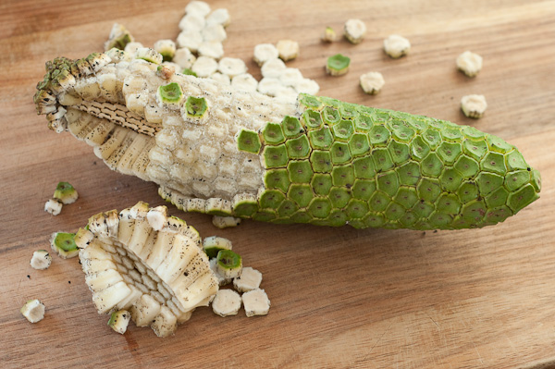

Slide 9
Keeping in step with the Spirit. Living by the Spirit.
Living by the Spirit begins when we are born again in Christ.
Continues as we daily walk with the Spirit.
A life transformed in Christ Jesus. The character of Jesus developing within us.
One fruit –– Many flavours
love
Love for God. Love for one another. Without love, we are nothing.
joy
Not dependant on ‘fleshly happiness’. Comes with an eternal perspective. Joy in salvation; Joy in being loved and known by God.
peace
our total trust in God, gives us peace. “God’s got this”
patience
The opposite of ‘short-tempered’. The Spirit overcomes our urge to lash out
kindness
Doing good. Even for those who have wronged us.
goodness
Only by the Spirit of God, can we truly be good. Goodness (especially of a generosity kind)
faithfulness
As God is faithful / trustworthy / can be relied upon, so must we
gentleness
Power controlled by the Spirit. Not used to bully.
self-control
Control of sensual desires
The character of Jesus develops within us, as we daily walk with Him (keeping in step)

